Slide 1
Unit Six
Local Art,Global Culture

Slide 2
1
Lead-in
目录
2
Tasks
3
Readings
CONTENTS
4
More Resources

Slide 3
1
PART
Lead-in

Slide 4
Part I Lead-in
A. Mona Lisa has been acclaimed as “the best known, the most visited, the most written about, the most sung about, the most parodied work of art in the world”. Please answer the following questions and share your knowledge about Mona Lisa with your partner.
1. Who is the painter? Which country does the painter come from?
2. Who is the subject of the painting?
3. Where is it displayed at present?
4. The painting was once stolen from the museum where it is exhibited. Do you know any detail about it?
5. Dadaists and surrealists often produce modifications and caricatures. Can you name any of them?
参考答案：
1. Leonardo da Vinci; Italy.
2. The model, Lisa del Giocondo, was a member of the Gherardini family of Florence and Tuscany, and the wife of wealthy Florentine silk merchant Francesco del Giocondo.
3. In Louvre Museum in Paris.
4. On 21 August, 1911, the painting was stolen from the Louvre. Two years later the thief was found. Louvre employee Vincenzo Peruggia stole the Mona Lisa by entering the building during regular hours.
5. Marcel Duchamp and Salvador Dalí.

Slide 5
Part I Lead-in
B. Discuss the following questions with your partner. Take notes in the box if
necessary.
1. Mona Lisa is renowned in the whole world for its aesthetic value. Why do you think this painting is so charming?
2. Mona Lisa was painted during Renaissance. How much do you know about this period? Would you like to live in that period? Why or Why not?
3. Given an opportunity to introduce one of Chinese paintings to the world, which work would you like to choose? Why?
点击此处添加标题
点击此处添加标题
标题数字等都可以通过点击和重新输入进行更改，顶部“开始”面板中可以对字体、字号、颜色等进行修改。建议正文8-14号字，1.3倍字间距。
标题数字等都可以通过点击和重新输入进行更改，顶部“开始”面板中可以对字体、字号、颜色等进行修改。建议正文8-14号字，1.3倍字间距。
标题数字等都可以通过点击和重新输入进行更改，顶部“开始”面板中可以对字体、字号、颜色等进行修改。建议正文8-14号字，1.3倍字间距。
参考答案：
1. Its popularity may lie in its depiction of a common civilian instead of a saint. Of course, the elegance and beauty of the lady possibly are the most important reasons for its charm.
2. It first originated in Italy with a rediscovery of the charm of the ancient Greek and Roman cultures. I would like to live in that period if possible, because it was a period of asserting human dignity and freedom.
3. I would like to introduce Nymph of the Luo River by Gu Kaizhi to the world due to its subtle artistic structure and vivid portraits.
点击此处添加标题
点击此处添加标题
标题数字等都可以通过点击和重新输入进行更改，顶部“开始”面板中可以对字体、字号、颜色等进行修改。建议正文8-14号字，1.3倍字间距。
标题数字等都可以通过点击和重新输入进行更改，顶部“开始”面板中可以对字体、字号、颜色等进行修改。建议正文8-14号字，1.3倍字间距。

Slide 6
2
PART
Tasks

Slide 7
Part II Tasks
Task One
Read Passage One and the following ten statements. Each statement contains information given in one of the paragraphs of Passage One. Identify the paragraph from which the information is derived. You may choose a paragraph more than once. Each paragraph is marked with one letter.
A
B
( ) 1. Amateur artists have played an important role in the development of Chinese art.
( ) 2. Artists get benefits from commercial areas.
( ) 3. Form and content are closely related to each other in Chinese art.
( ) 4. Chinese art has become more and more popular around the world.
( ) 5. Chinese art is not essentially religious.
( ) 6. Chinese art is featured with metaphysical aspect.
( ) 7. Many symbols have found their way into Chinese art.
( ) 8. Chinese art puts more emphasis on inner essence.
( ) 9. Artistic works have played a role in building up one’s social position.
( ) 10. Chinese art is featured with the moral aspect.
H
A
E
B
E
C
C
D
G
F
H
D

Slide 8
Part II Tasks
Task Two
Read Passage Two and decide whether the following statements are true (T) or false (F).
( ) 1. The “artistic” regions of our brain have made it possible to produce a multisensory
experience during dance.
( ) 2. Mathematics can bring forth the intuitive logic of the music system.
( ) 3. Neurons survive by connecting with each other.
( ) 4. Art’s beauty derives from its ability to draw the mind’s attention.
( ) 5. The connection between science and art is the mortal force.
F
A
B
F
T
T
F
C
D

Slide 9
Part II Tasks
Task Three
Read Passage Three, and answer the following questions.
A
B
1. Why did C. P. Snow put forward the idea of a third culture?
参考答案：
1. C.P. Snow tended to simplify and generalize his thesis about the gap between the sciences and the humanities.
C
D

Slide 10
Part II Tasks
Task Three
Read Passage Three, and answer the following questions.
A
B
2. How does the idea of art as a space between sciences and humanities come into being?
参考答案：
2. It is a resutt of the fact that one of the most important characteristics of the last century’s artistic practice is the technologization of art.
C
D

Slide 11
Part II Tasks
Task Three
Read Passage Three, and answer the following questions.
A
B
3. What does a reflective attitude towards technology outside the artistic context result in?
参考答案：
3. It resulted in a development of art in which the artistic, technological and cultural discourse
infiltrate each other.
C
D

Slide 12
Part II Tasks
Task Three
Read Passage Three, and answer the following questions.
A
B
4. What is the influence of scientific and technological revolution on life?
参考答案：
4. The borders between life and technology are gradually blurring.
C
D

Slide 13
Part II Tasks
Task Three
Read Passage Three, and answer the following questions.
A
B
5. Why can artists who technologize their practice be considered the pioneers of the third culture?
参考答案：
5. Because, existing between the two camps, benefiting from their traditions and achievements, they have at the same time the chance of keeping a critical distance from them.
C
D

Slide 14
Part II Tasks
Task Four
Read Passage Four and Passage Five carefully, and choose the best answer to each question.
( ) 1. How does Ibrahim El-Salahi maintain a strong link to his homeland in his art?
A. By fusing his own experience of Islamic, African, Arab and Western artistic
traditions.
B. By returning to his native Sudan.
C. By using the deep yellow color of the Sudanese earth.
D. By experimenting with modern forms.
( ) 2. Which of the following statements best describes the feature of Meschac Gaba’s art?
A. He creates “a new reality”.
B. He uses his hometown as a workspace for posing questions about global
contemporary art.
C. He invites the Western art establishment to engage with African art.
D. He roots his art in African cultural heritage.
C
点击此处添加标题
点击此处添加标题
标题数字等都可以通过点击和重新输入进行更改，顶部“开始”面板中可以对字体、字号、颜色等进行修改。建议正文8-14号字，1.3倍字间距。
标题数字等都可以通过点击和重新输入进行更改，顶部“开始”面板中可以对字体、字号、颜色等进行修改。建议正文8-14号字，1.3倍字间距。
标题数字等都可以通过点击和重新输入进行更改，顶部“开始”面板中可以对字体、字号、颜色等进行修改。建议正文8-14号字，1.3倍字间距。
B
点击此处添加标题
标题数字等都可以通过点击和重新输入进行更改，顶部“开始”面板中可以对字体、字号、颜色等进行修改。建议正文8-14号字，1.3倍字间距。
标题数字等都可以通过点击和重新输入进行更改，顶部“开始”面板中可以对字体、字号、颜色等进行修改。建议正文8-14号字，1.3倍字间距。

Slide 15
Part II Tasks
Task Four
Read Passage Four and Passage Five carefully, and choose the best answer to each question.
( ) 3. Marlene Dumas’s works is NOT famous for ______.
A. her biblical figures
B. issues of gender and sexuality
C. symbolic meanings of nakedness
D. the blurring boundaries between genders
( ) 4. What attitude has long existed in the Western world toward Asian art?
A. Asian art has a long and unique history.
B. Asian art is inspired by both modernist traditions and its origins.
C. Asian art is entirely exotic.
D. Asian art is a way for artists to celebrate their identities.
A
点击此处添加标题
点击此处添加标题
标题数字等都可以通过点击和重新输入进行更改，顶部“开始”面板中可以对字体、字号、颜色等进行修改。建议正文8-14号字，1.3倍字间距。
标题数字等都可以通过点击和重新输入进行更改，顶部“开始”面板中可以对字体、字号、颜色等进行修改。建议正文8-14号字，1.3倍字间距。
标题数字等都可以通过点击和重新输入进行更改，顶部“开始”面板中可以对字体、字号、颜色等进行修改。建议正文8-14号字，1.3倍字间距。
C
点击此处添加标题
标题数字等都可以通过点击和重新输入进行更改，顶部“开始”面板中可以对字体、字号、颜色等进行修改。建议正文8-14号字，1.3倍字间距。
标题数字等都可以通过点击和重新输入进行更改，顶部“开始”面板中可以对字体、字号、颜色等进行修改。建议正文8-14号字，1.3倍字间距。

Slide 16
Part II Tasks
Task Four
Read Passage Four and Passage Five carefully, and choose the best answer to each question.
( ) 5. What unrecognized and taboo culture is celebrated in the figure of Khakar’s “You Can’t
Please All”?
A. His Indian identity.
B. Images of deities.
C. His homosexuality.
D. His humor.
( ) 6. Which of the following information is NOT true about to Amrita Sher-Gil?
A. She has an international background.
B. She is one of the artists to set precedents for female Asian artists.
C. She paints the lives of India’s cultures with modernist tendencies.
D. She explores the ideas of distance and home in her works.
C
点击此处添加标题
点击此处添加标题
标题数字等都可以通过点击和重新输入进行更改，顶部“开始”面板中可以对字体、字号、颜色等进行修改。建议正文8-14号字，1.3倍字间距。
标题数字等都可以通过点击和重新输入进行更改，顶部“开始”面板中可以对字体、字号、颜色等进行修改。建议正文8-14号字，1.3倍字间距。
标题数字等都可以通过点击和重新输入进行更改，顶部“开始”面板中可以对字体、字号、颜色等进行修改。建议正文8-14号字，1.3倍字间距。
D
点击此处添加标题
标题数字等都可以通过点击和重新输入进行更改，顶部“开始”面板中可以对字体、字号、颜色等进行修改。建议正文8-14号字，1.3倍字间距。
标题数字等都可以通过点击和重新输入进行更改，顶部“开始”面板中可以对字体、字号、颜色等进行修改。建议正文8-14号字，1.3倍字间距。

Slide 17
Part II Tasks
Task Five
Passage Two and Passage Three both are about the relationship between art and science. Discuss with your group members about the different skills used by the authors to develop their ideas and write a critical article to summarize your discussions in about 120 words.
点击此处添加标题
点击此处添加标题
参考答案：
Obviously, Passage Two and Passage Three have adopted different skills to develop the idea that art and science are interconnected. In Passage Two, some examples are provided to convince us. To be specific, Passage Two uses the respective findings of one artist and one scientist to argue for the idea. Cristina Stefanon, a pianist, compared the mystery of music to the beauty of mathematics while Dinko Mitrečić? a neuroscientist, showed the interconnection between human neurons. On the other hand, Passage Three, in spite of some specific evidences, develops its idea through general explanations and claims. It focuses on the influence of technology on contemporary art and infiltration between science and art. Contemporary digital art may be the best evidence to the interconnection between art and science.
标题数字等都可以通过点击和重新输入进行更改，顶部“开始”面板中可以对字体、字号、颜色等进行修改。建议正文8-14号字，1.3倍字间距。
标题数字等都可以通过点击和重新输入进行更改，顶部“开始”面板中可以对字体、字号、颜色等进行修改。建议正文8-14号字，1.3倍字间距。
标题数字等都可以通过点击和重新输入进行更改，顶部“开始”面板中可以对字体、字号、颜色等进行修改。建议正文8-14号字，1.3倍字间距。
点击此处添加标题
标题数字等都可以通过点击和重新输入进行更改，顶部“开始”面板中可以对字体、字号、颜色等进行修改。建议正文8-14号字，1.3倍字间距。
标题数字等都可以通过点击和重新输入进行更改，顶部“开始”面板中可以对字体、字号、颜色等进行修改。建议正文8-14号字，1.3倍字间距。

Slide 18
Part II Tasks
Task Six
Passage Four and Passage Five are about the local art in a global context. Discuss the following questions with your group members.
点击此处添加标题
点击此处添加标题
1. There are two contradictory slogans, that is, “the more local, the more global” and “the more global, the more local”. What do you think of the two slogans?
标题数字等都可以通过点击和重新输入进行更改，顶部“开始”面板中可以对字体、字号、颜色等进行修改。建议正文8-14号字，1.3倍字间距。
标题数字等都可以通过点击和重新输入进行更改，顶部“开始”面板中可以对字体、字号、颜色等进行修改。建议正文8-14号字，1.3倍字间距。
标题数字等都可以通过点击和重新输入进行更改，顶部“开始”面板中可以对字体、字号、颜色等进行修改。建议正文8-14号字，1.3倍字间距。
参考答案：
1. I think neither of the slogans are convincing. We need to keep a balance between the local
and the global cultures.
点击此处添加标题
标题数字等都可以通过点击和重新输入进行更改，顶部“开始”面板中可以对字体、字号、颜色等进行修改。建议正文8-14号字，1.3倍字间距。
标题数字等都可以通过点击和重新输入进行更改，顶部“开始”面板中可以对字体、字号、颜色等进行修改。建议正文8-14号字，1.3倍字间距。

Slide 19
Part II Tasks
Task Six
Passage Four and Passage Five are about the local art in a global context. Discuss the following questions with your group members.
点击此处添加标题
点击此处添加标题
2. How do you think an artist can keep a balance between his or her local identity and global
perspective?
标题数字等都可以通过点击和重新输入进行更改，顶部“开始”面板中可以对字体、字号、颜色等进行修改。建议正文8-14号字，1.3倍字间距。
标题数字等都可以通过点击和重新输入进行更改，顶部“开始”面板中可以对字体、字号、颜色等进行修改。建议正文8-14号字，1.3倍字间距。
标题数字等都可以通过点击和重新输入进行更改，顶部“开始”面板中可以对字体、字号、颜色等进行修改。建议正文8-14号字，1.3倍字间距。
参考答案：
2. While highlighting the local color, an artist can learn artistic experience for the global
cultures. Moreover, an artist can communicate his or her talents with the global counterparts.
点击此处添加标题
标题数字等都可以通过点击和重新输入进行更改，顶部“开始”面板中可以对字体、字号、颜色等进行修改。建议正文8-14号字，1.3倍字间距。
标题数字等都可以通过点击和重新输入进行更改，顶部“开始”面板中可以对字体、字号、颜色等进行修改。建议正文8-14号字，1.3倍字间距。

Slide 20
Part II Tasks
Task Six
Passage Four and Passage Five are about the local art in a global context. Discuss the following questions with your group members.
点击此处添加标题
点击此处添加标题
3. Though Passage Four and Passage Five respectively talk about African and Asian artists, there are similarities between artists mentioned in the two passages. What are they? Do you know any Chinese artist who has won global recognition without abandoning his or her Chinese identity? If yes, share your information with your partner. If no, please look up some information by means of sources like Internet or magazines.
标题数字等都可以通过点击和重新输入进行更改，顶部“开始”面板中可以对字体、字号、颜色等进行修改。建议正文8-14号字，1.3倍字间距。
标题数字等都可以通过点击和重新输入进行更改，顶部“开始”面板中可以对字体、字号、颜色等进行修改。建议正文8-14号字，1.3倍字间距。
标题数字等都可以通过点击和重新输入进行更改，顶部“开始”面板中可以对字体、字号、颜色等进行修改。建议正文8-14号字，1.3倍字间距。
参考答案：
3. African and Asian artists both integrate their local culture into the western artistic tradition. The film director Zhang Yimou is a Chinese artist who has won global recognition without abandoning his Chinese identity.
点击此处添加标题
标题数字等都可以通过点击和重新输入进行更改，顶部“开始”面板中可以对字体、字号、颜色等进行修改。建议正文8-14号字，1.3倍字间距。
标题数字等都可以通过点击和重新输入进行更改，顶部“开始”面板中可以对字体、字号、颜色等进行修改。建议正文8-14号字，1.3倍字间距。

Slide 21
3
PART
Readings

Slide 22
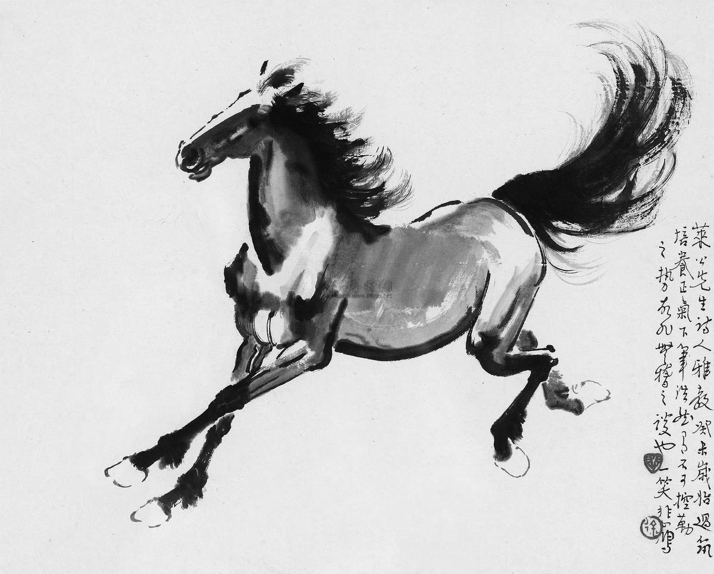
Part III Readings
Passage One
Chinese Art
点击此处添加标题
点击此处添加标题
A. Contemporary art in China covers a wide range of art forms, including painting, sculpture, film, video, photography, installation and performance, as well as revived versions of traditional ceramics. The emergence of new commercial areas, like the 798 Art District in Dashanzi of Beijing, has proved helpful to many artists. In 2000, China staged the Shanghai Biennial Festival and in 2003 a number of Chinese artists were represented at the Venice Biennale of 2003.
标题数字等都可以通过点击和重新输入进行更改，顶部“开始”面板中可以对字体、字号、颜色等进行修改。建议正文8-14号字，1.3倍字间距。
标题数字等都可以通过点击和重新输入进行更改，顶部“开始”面板中可以对字体、字号、颜色等进行修改。建议正文8-14号字，1.3倍字间距。
标题数字等都可以通过点击和重新输入进行更改，顶部“开始”面板中可以对字体、字号、颜色等进行修改。建议正文8-14号字，1.3倍字间距。
点击此处添加标题
标题数字等都可以通过点击和重新输入进行更改，顶部“开始”面板中可以对字体、字号、颜色等进行修改。建议正文8-14号字，1.3倍字间距。
标题数字等都可以通过点击和重新输入进行更改，顶部“开始”面板中可以对字体、字号、颜色等进行修改。建议正文8-14号字，1.3倍字间距。
ceramics n. 制陶术

Slide 23
Part III Readings
Passage One
B. According to the Artprice report, the total revenue generated by one hundred Chinese artists in 2003–2004 amounted to a mere ￡860,000. In the year 2007 to 2008, the revenue of paintings, sculptures and other works reached a massive ￡270m. Of these, three artists each made more than ￡25 million. Not surprisingly, numerous works by contemporary Asian artists are now represented in galleries and museums across the world, and the eminent British art collector Charles Saatchi opened his new gallery in Chelsea with an exhibition of contemporary Chinese artists. Generally speaking, Chinese art has following characteristics:

Slide 24
Part III Readings
Passage One
C. First, ever since the era of Prehistoric art, Chinese society — itself almost wholly agricultural or rural until the 20th century — has always placed great importance on understanding the pattern of nature and co-existing with it. Nature was perceived as the visible manifestation of God’s creativity, using the interaction of the yin (female) and yang (male) life forces. The main aim of Chinese art — initially centered on propitiation and sacrifice — soon turned to the expression of human understanding of these life forces. The Chinese also believed that the energy and rhythm generated by an artist resonated closely with the ultimate source of that energy. They thought that art — especially calligraphy and painting — had the capacity to refresh the artist or to retard him spiritually, according to the harmony of his practice and the character of the individual himself.
propitiation n. 安抚，和解

Slide 25
Part III Readings
D. Second, Chinese art also had social and moralistic functions. The earliest mural paintings, for instance, portrayed benevolent emperors, wise ministers, loyal generals, as well as their evil opposites, as an example and a warning to observers. Portrait art had a similar moral function, which aimed to highlight not the facial or figurative features of the subject so much as his or her character and status in society.
E. Third, court painters were frequently commissioned to depict auspicious and memorable events, but high religious painting is unknown in Chinese art. Even Buddhism, which stimulated the production of numerous masterpieces, was actually a foreign import. The main thing is that themes used in traditional Chinese art were almost always noble, or inspirational. Thus overly realistic subjects such as war, death, violence, martyrdom or even the nude, were avoided. Furthermore, Chinese artistic tradition does not separate form from content: it is not enough, for instance, for the form to be exquisite if the subject is unedifying.
unedifying adj. 无益于教化的，无启发性的

Slide 26
Part III Readings
F. Fourth, unlike Western artists, Chinese painters were not interested in replicating nature, or creating a true-life depiction of a landscape. Instead, they focused on expressing the inner essence of the subject. Remember, rocks and streams were seen as “live” things, visible manifestations of the invisible forces of the cosmos. Therefore, it was the role of the artist to capture the spiritual rather than the material characteristics of the object concerned.
G. Fifth, Chinese art is full of symbolism, in that artists typically seek to depict some aspect of a totality of which they are intuitively aware. In addition, Chinese art is filled with specific symbols: bamboo represents a spirit which can be bent by circumstance but not broken; jade represents purity; a dragon often symbolizes the emperor; the crane, long life; a pair of ducks, fidelity in marriage. Some art critics, however, prefer to describe Chinese art as essentially expressionist, rather than symbolic.
H. Last but not the least, during the Warring States Period and the Han Dynasty, the growth of a merchant and landowning class led to increased numbers of art lovers and patrons with time on their hands. This led to the emergence in the third century of an elite class of scholarly amateur artists, involved in the arts of poetry, calligraphy, painting and a range of crafts.

Slide 27
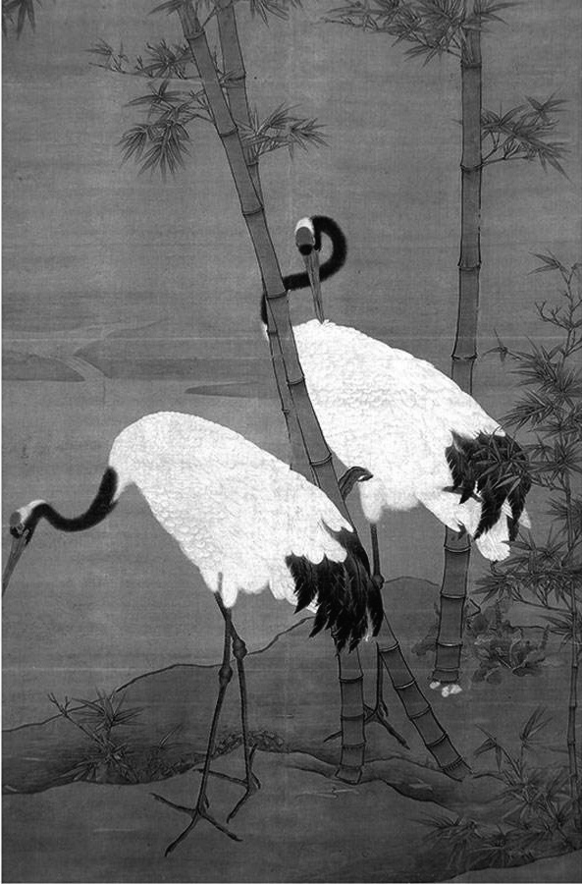
Part III Readings
These amateurs tended to look down their nose at the lower-class professional artist, employed by the Imperial court, and other regional or civic authorities. Moreover, this division of artists later had a significant influence on the character of Chinese art. From the Song Dynasty (960–1279) on, the gentlemen-artists became closely associated with increasingly refined forms of ink and wash painting and calligraphy, and their works became an important media of exchange in a social economy where the giving of presents was a vital step in building up a personal network. Just like skill in writing letters or poetry, the ability to excel at calligraphy and painting helped establish one’s status in a society of learned individuals.

Slide 28
Part III Readings
Passage Two
Art and Science
A significantly improved understanding of the “artistic” regions of our brain has begun to motivate modern art performers to include science and scientific methods in the process of art production. Detection of electrical activity during muscle contraction can be transformed into colors or sounds, thus producing a multisensory experience during dance. So, can we exist as separate entities, scientists and artists, anymore?
点击此处添加标题
点击此处添加标题
标题数字等都可以通过点击和重新输入进行更改，顶部“开始”面板中可以对字体、字号、颜色等进行修改。建议正文8-14号字，1.3倍字间距。
标题数字等都可以通过点击和重新输入进行更改，顶部“开始”面板中可以对字体、字号、颜色等进行修改。建议正文8-14号字，1.3倍字间距。
标题数字等都可以通过点击和重新输入进行更改，顶部“开始”面板中可以对字体、字号、颜色等进行修改。建议正文8-14号字，1.3倍字间距。
点击此处添加标题
标题数字等都可以通过点击和重新输入进行更改，顶部“开始”面板中可以对字体、字号、颜色等进行修改。建议正文8-14号字，1.3倍字间距。
标题数字等都可以通过点击和重新输入进行更改，顶部“开始”面板中可以对字体、字号、颜色等进行修改。建议正文8-14号字，1.3倍字间距。

Slide 29
Part III Readings
To strengthen the connection between art and science, Cristina Stefanon, pianist, presented her idea that the mystery of music can be revealed in beauty of mathematics. Although mathematics cannot reveal all the secrets of the inversions of Bach's fugues or the intuitive logic of the music system, it has opened new horizons to a better understanding of both art and science: it is in between moments of silence, in between mathematical equations, where the beauty sleeps. Moreover, Dinko Mitrečić? neuroscientist, revealed a medical fact with intriguing artistic significance: neurons, cells that comprise neuronal networks, the configuration and extent of which constitute the critical difference between human and animals, depend on something: to survive, they must forge synaptic contacts with each other.
fugue n. 赋格曲
synaptic adj. 有突触的，（染色体）结合的

Slide 30
Part III Readings
No neuron can survive as an island, no neuron can survive without reaching for another neuron, or many others. The strength of those connections, measurable by scientific parameters, reveals which biologic elements allow humans to be humans, to build consciousness and to be able to express love for others. Like the connection between an unborn child and his parents, partly hidden in an inscrutable, indescribable mist, but miraculously revealed in growing anticipation and visionary dreams, our spiritual, mental, and physical potential can be fully reached by letting the energy of art and science dance together and bring us closer to understanding ?where we are and where we are heading.
parameter n. 参数；限制因素
inscrutable adj. 不可理解的，迷一样的

Slide 31
Part III Readings
From the microscopic, cellular level to the level of societal networks, from science to art — whatever side we take as a starting point, there is always the immortal force that motivates humans to better understand and better express the beauty hidden in everything around us. Indeed, only beautiful science can be important and only art which intrigues the mind can be beautiful. When taken together, the gap between art and science is bridged, again and again, by profound connections which imbue our lives with meaning. The uppermost truth cannot be reached, but can be presented by a work of art. And that’s where science needs art and art needs science.
imbue v. 灌输，浸染

Slide 32
Part III Readings
Passage Three
A Third Culture
Although presented half a century ago, the thesis by C. P. Snow about the gap between the sciences and the humanities is still an important reference point for considerations on the state of the relation between them. However, Snow was aware of the simplifications and generalizations. Therefore, he later supplemented the pessimistic point with an optimistic idea for the future, pointing to the fact that the gap is not impassable. The awareness of the difference is rather a condition of a dialogue coming into being, and it makes the emergence of a third culture possible.
The idea of the third culture seems especially interesting in the era of a permanent scientific and technological revolution, which transforms the world surrounding us, our lives, and ourselves almost overnight. The borders between life and technology are gradually blurring. As much as the gap between sciences and the humanities does not disappear from the landscape of contemporary culture, the idea of “bridging the gap between the humanities and the sciences” has found a remarkable place in contemporary art.
点击此处添加标题
点击此处添加标题
标题数字等都可以通过点击和重新输入进行更改，顶部“开始”面板中可以对字体、字号、颜色等进行修改。建议正文8-14号字，1.3倍字间距。
标题数字等都可以通过点击和重新输入进行更改，顶部“开始”面板中可以对字体、字号、颜色等进行修改。建议正文8-14号字，1.3倍字间距。
标题数字等都可以通过点击和重新输入进行更改，顶部“开始”面板中可以对字体、字号、颜色等进行修改。建议正文8-14号字，1.3倍字间距。
点击此处添加标题
标题数字等都可以通过点击和重新输入进行更改，顶部“开始”面板中可以对字体、字号、颜色等进行修改。建议正文8-14号字，1.3倍字间距。
标题数字等都可以通过点击和重新输入进行更改，顶部“开始”面板中可以对字体、字号、颜色等进行修改。建议正文8-14号字，1.3倍字间距。

Slide 33
Part III Readings
The idea of art as a space in between, as a bridge connecting two cultures is not as much a result of the prehistoric similarities, as it is of the fact that one of the most important characteristics of the last century’s artistic practice is the technologization of art associated with the use of new technologies and media as tools by artists. Artists have always searched for new ways and new tools extending the range of aesthetic but also cognitive possibilities of art. They opened new aesthetic possibilities but were subject to critical consideration just as frequently. The reflective attitude towards technology created and generally used outside the artistic context, enabled a development of art in which the artistic, technological and cultural discourse infiltrate each other, influence each other and mutually determine each other.
aesthetic adj. 美学的
infiltrate v. 渗透，潜入

Slide 34
Part III Readings
Passage Three
The artists who make use of the achievements of contemporary science and up to date technology in their practice can be considered the pioneers of the third culture, because, existing between the two camps, benefiting from their traditions and achievements, they have at the same time the chance of keeping a critical distance from them. The idea of the artist as a researcher and art as research, the definition of the position of the artist in terms of active, creative but at the same time critical participation in the scientific and technological revolution, and understanding his activity as a “practice informed by theory” have become one of the main approaches towards contemporary digital art.
点击此处添加标题
点击此处添加标题
标题数字等都可以通过点击和重新输入进行更改，顶部“开始”面板中可以对字体、字号、颜色等进行修改。建议正文8-14号字，1.3倍字间距。
标题数字等都可以通过点击和重新输入进行更改，顶部“开始”面板中可以对字体、字号、颜色等进行修改。建议正文8-14号字，1.3倍字间距。
标题数字等都可以通过点击和重新输入进行更改，顶部“开始”面板中可以对字体、字号、颜色等进行修改。建议正文8-14号字，1.3倍字间距。
点击此处添加标题
标题数字等都可以通过点击和重新输入进行更改，顶部“开始”面板中可以对字体、字号、颜色等进行修改。建议正文8-14号字，1.3倍字间距。
标题数字等都可以通过点击和重新输入进行更改，顶部“开始”面板中可以对字体、字号、颜色等进行修改。建议正文8-14号字，1.3倍字间距。

Slide 35
Part III Readings
Passage Four
African Artists
Having studied in London, Ibrahim El-Salahi returned to his native Sudan and forged a visual vocabulary by fusing his own experience of Islamic, African, Arab and Western artistic traditions. Using the deep yellow color of the Sudanese earth in his paintings, El-Salahi has maintained strong links to his homeland while experimenting with modern forms. While staying rooted, he stands as a global example by using his art to address, as he says, “your self, the people of your own culture, family, and neighborhood, and finally all human beings, wherever they might be.” Only recently has this major figure in African modernism been brought into a more global art history through the efforts of major exhibitions.
In terms of contemporary art, many African artists have followed El-Salahi’s lead by making works that speak to their own experience as well as a global audience.
点击此处添加标题
点击此处添加标题
标题数字等都可以通过点击和重新输入进行更改，顶部“开始”面板中可以对字体、字号、颜色等进行修改。建议正文8-14号字，1.3倍字间距。
标题数字等都可以通过点击和重新输入进行更改，顶部“开始”面板中可以对字体、字号、颜色等进行修改。建议正文8-14号字，1.3倍字间距。
标题数字等都可以通过点击和重新输入进行更改，顶部“开始”面板中可以对字体、字号、颜色等进行修改。建议正文8-14号字，1.3倍字间距。
点击此处添加标题
标题数字等都可以通过点击和重新输入进行更改，顶部“开始”面板中可以对字体、字号、颜色等进行修改。建议正文8-14号字，1.3倍字间距。
标题数字等都可以通过点击和重新输入进行更改，顶部“开始”面板中可以对字体、字号、颜色等进行修改。建议正文8-14号字，1.3倍字间距。

Slide 36
Part III Readings
Passage Four
Meschac Gaba, for example, draws his greatest inspiration from his hometown of Cotonou, Benin, in West Africa, but uses this African city as a workspace for posing questions about global contemporary art. His Museum of Contemporary African Art in London (2013) creates what he calls “a new reality” by staging an exhibition that speaks to his experience of Africa set within the space of a European gallery. By doing so, he invites the Western art establishment to engage with African art, but also to question why dedicated spaces like this don’t exist already.
点击此处添加标题
点击此处添加标题
标题数字等都可以通过点击和重新输入进行更改，顶部“开始”面板中可以对字体、字号、颜色等进行修改。建议正文8-14号字，1.3倍字间距。
标题数字等都可以通过点击和重新输入进行更改，顶部“开始”面板中可以对字体、字号、颜色等进行修改。建议正文8-14号字，1.3倍字间距。
标题数字等都可以通过点击和重新输入进行更改，顶部“开始”面板中可以对字体、字号、颜色等进行修改。建议正文8-14号字，1.3倍字间距。
点击此处添加标题
标题数字等都可以通过点击和重新输入进行更改，顶部“开始”面板中可以对字体、字号、颜色等进行修改。建议正文8-14号字，1.3倍字间距。
标题数字等都可以通过点击和重新输入进行更改，顶部“开始”面板中可以对字体、字号、颜色等进行修改。建议正文8-14号字，1.3倍字间距。

Slide 37
Part III Readings
South African artist Marlene Dumas, on the other hand, explores issues of gender and sexuality in her paintings, as evident in her Magdalena series. Dumas uses nakedness to explore themes of love and fear, intimacy and distance. Her female figures take on subtle male qualities, and vice versa, blurring boundaries and creating a real sense of vulnerability in her paintings. The name Magdalena refers to the biblical figure of Mary Magdalene, a popular reference that viewers from different cultures could potentially understand.
vulnerability n. 脆弱性，弱点
biblical adj. 圣经的
Mary Magdalene 抹大拉的玛利亚（耶稣从其身上驱逐出七个恶鬼）

Slide 38
Part III Readings
Passage Five
Asian Artists
The arts of Asia share a long and unique history, stretching from thousands of years ago into a rich modern and contemporary practice today. At the height of modernism in the middle of the 20th century, artists like Japan’s Yayoi Kusama were flourishing among the New York art scene. They were inspired by modernist traditions while forging unique voices linked to their origins and identities. In what we call the Western world, there had long been a tendency to look at the art of Asia from an orientalist perspective, treating it as “other”, as something entirely exotic. But as you’ll soon see, modern and contemporary Asian artists have launched a tradition of instigating global engagement while celebrating their identities.
exotic adj. 奇异的，外来的
instigate v. 鼓动

Slide 39
Part III Readings
Indian painter Bhupen Khakar, for example, achieved international recognition for his work in the 1960s and was proclaimed to be India’s first pop artist. His works were inspired by and often incorporated images of deities and other traditionally Indian genres, such as miniatures and temple maps. Khakar managed to communicate these images with humor as well as a sense of celebration, depicting a culture mostly unrecognized in the West in its true form. In “You Can’t Please All”, a naked, life-sized self portrait looks out over an unfolding townscape. With this figure, Khakar found a way to proclaim even more than just his heritage — in this case, his homosexuality — and celebrate an even more deeply unrecognized and taboo culture.
点击此处添加标题
点击此处添加标题
标题数字等都可以通过点击和重新输入进行更改，顶部“开始”面板中可以对字体、字号、颜色等进行修改。建议正文8-14号字，1.3倍字间距。
标题数字等都可以通过点击和重新输入进行更改，顶部“开始”面板中可以对字体、字号、颜色等进行修改。建议正文8-14号字，1.3倍字间距。
标题数字等都可以通过点击和重新输入进行更改，顶部“开始”面板中可以对字体、字号、颜色等进行修改。建议正文8-14号字，1.3倍字间距。
点击此处添加标题
标题数字等都可以通过点击和重新输入进行更改，顶部“开始”面板中可以对字体、字号、颜色等进行修改。建议正文8-14号字，1.3倍字间距。
deity n. 女神

Slide 40
Part III Readings
Meanwhile, Indian artists Amrita Sher-Gil and later Zarina Hashmi set precedents for what female Asian artists could be capable of. Sher-Gil was born to Hungarian and Sikh parents and experienced an international education, particularly through the vibrant atmosphere of 1930s Paris. She returned to India with modernist tendencies and a drive to paint the lives of India’s cultures. Hashmi also studied overseas — in New York — where she remains to this day, creating collages using maps, writing, and delicate paper, exploring the ideas of distance and home.
点击此处添加标题
点击此处添加标题
标题数字等都可以通过点击和重新输入进行更改，顶部“开始”面板中可以对字体、字号、颜色等进行修改。建议正文8-14号字，1.3倍字间距。
标题数字等都可以通过点击和重新输入进行更改，顶部“开始”面板中可以对字体、字号、颜色等进行修改。建议正文8-14号字，1.3倍字间距。
标题数字等都可以通过点击和重新输入进行更改，顶部“开始”面板中可以对字体、字号、颜色等进行修改。建议正文8-14号字，1.3倍字间距。
点击此处添加标题
标题数字等都可以通过点击和重新输入进行更改，顶部“开始”面板中可以对字体、字号、颜色等进行修改。建议正文8-14号字，1.3倍字间距。
标题数字等都可以通过点击和重新输入进行更改，顶部“开始”面板中可以对字体、字号、颜色等进行修改。建议正文8-14号字，1.3倍字间距。
precedent n. 先例
collages n. 拼贴画

Slide 41
4
PART
More Resources

Slide 42
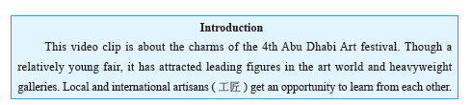
Part IV More Resources
A. Enjoy the video.
http://english.cntv.cn/program/cultureexpress/20121110/104996.shtml
点击此处添加标题
点击此处添加标题
标题数字等都可以通过点击和重新输入进行更改，顶部“开始”面板中可以对字体、字号、颜色等进行修改。建议正文8-14号字，1.3倍字间距。
标题数字等都可以通过点击和重新输入进行更改，顶部“开始”面板中可以对字体、字号、颜色等进行修改。建议正文8-14号字，1.3倍字间距。
标题数字等都可以通过点击和重新输入进行更改，顶部“开始”面板中可以对字体、字号、颜色等进行修改。建议正文8-14号字，1.3倍字间距。
点击此处添加标题
标题数字等都可以通过点击和重新输入进行更改，顶部“开始”面板中可以对字体、字号、颜色等进行修改。建议正文8-14号字，1.3倍字间距。
标题数字等都可以通过点击和重新输入进行更改，顶部“开始”面板中可以对字体、字号、颜色等进行修改。建议正文8-14号字，1.3倍字间距。

Slide 43
Part IV More Resources
B. Surf the Internet.
1. http://edition.cnn.com/style/arts
This website offers latest information about artistic phenomena, movements and trends.
2. http://www.metmuseum.org/
This website is the official site of the Metropolitan Museum of Art, located in New York City. Visitors can get to know over two million works collected in the largest art museum in the United States and among the most visited art museums in the world.
3. http://cctv.cntv.cn/lm/cultureexpress/index.shtml
This website is a window to both Chinese and world arts. More importantly, art is introduced in the context of culture.
点击此处添加标题
点击此处添加标题
标题数字等都可以通过点击和重新输入进行更改，顶部“开始”面板中可以对字体、字号、颜色等进行修改。建议正文8-14号字，1.3倍字间距。
标题数字等都可以通过点击和重新输入进行更改，顶部“开始”面板中可以对字体、字号、颜色等进行修改。建议正文8-14号字，1.3倍字间距。
标题数字等都可以通过点击和重新输入进行更改，顶部“开始”面板中可以对字体、字号、颜色等进行修改。建议正文8-14号字，1.3倍字间距。
点击此处添加标题
标题数字等都可以通过点击和重新输入进行更改，顶部“开始”面板中可以对字体、字号、颜色等进行修改。建议正文8-14号字，1.3倍字间距。
标题数字等都可以通过点击和重新输入进行更改，顶部“开始”面板中可以对字体、字号、颜色等进行修改。建议正文8-14号字，1.3倍字间距。

